Slide 1


ASP.NET Core Performance Traces in Kubernetes
Mike Rousos
Principal Software Engineer, .NET Customer Engagement Team

Slide 2
Available .NET Core Diagnostic Tools
CLI tools
dotnet-trace
dotnet-dump
dotnet-gcdump
dotnet-counters
dotnet-monitor*
Other options
PerfCollect
CreateDump
COMPlus_DbgEnableMiniDump

Slide 3
Container challenges
Tool deployment
.NET Core SDK
Crossgen
Tool permissions
Environment variables
Sidecar configuration
Share process namespace
Volume mount /tmp
Ephemeral containers will be useful, but are in alpha and not yet supported on AKS
 | Profile locally | Profile from sidecar
dotnet-trace | Install ahead-of-time or copy from SDK container | Requires /tmp shared and shared process namespace
PerfCollect | Requires env vars and SYS_ADMIN | Requires env vars, sidecar SYS_ADMIN, and shared process namespace
Notes:
Tool sizes (for Linux x64 as of November 2nd, 2020; this is, of course, subject to change)
dotnet-dump: 50MB
dotnet-gcdump: 10MB
dotnet-counters: 10MB
dotnet-trace: 10MB

Slide 4


Tracing tool comparison
Dotnet-trace
Installed by SDK
Easy to use (no privileges required)
Managed callstacks only
Requires .NET Core 3.0+
Requires access to /tmp directory
PerfCollect
Installed via downloaded script
Requires .NET Core 2.1+
Managed and native callstacks
Requires SYS_ADMIN capability (or sudo)
Requires environment variables to be set prior to running the target

Slide 5
Dump tool comparison
Dotnet-dump
Installed by SDK
Easy to use (no privileges required)
Dumps must be analyzed on same OS and architecture
Only captures managed information
Dotnet-gcdump
Installed by SDK
Easy to use (no privileges required)
Dumps can be analyzed on Windows in VS or PerfView
Only captures heap information
Createdump
Installed automatically with runtime
Captures both managed and native stacks
Requires SYS_PTRACE capability (or sudo)
More complex to open dumps (requires runtime files from original process)

Slide 6
Demo
Collecting diagnostics in an AKS environment

Slide 7

Thanks for joining!
https://docs.microsoft.com/dotnet/core/diagnostics/diagnostics-in-containers

Slide 8








Slide 9




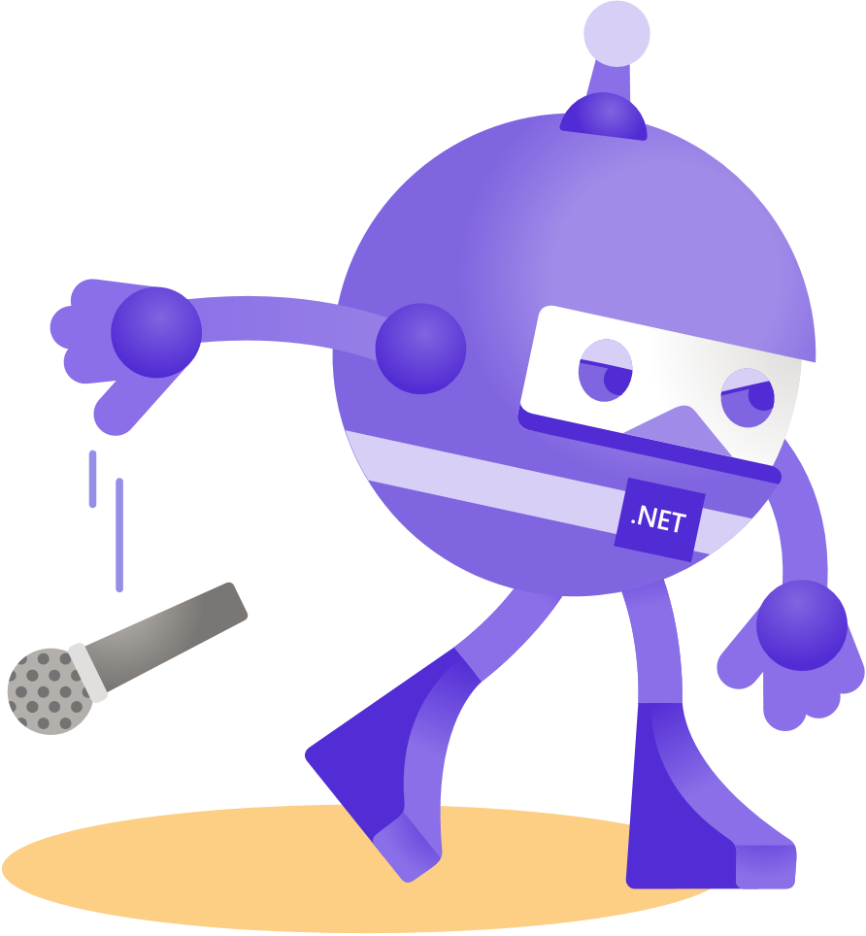




Slide 10








Slide 11


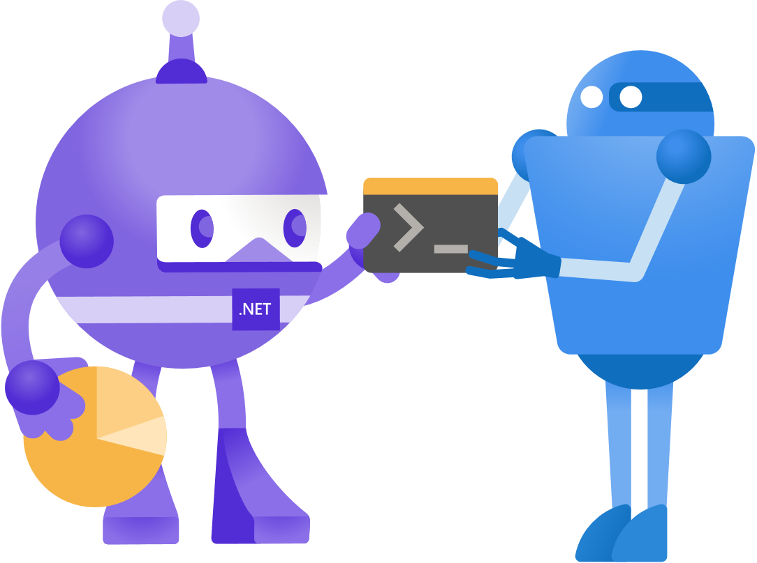






Slide 12





Slide 13


Slide 14


Slide 15


Slide 16


Slide 17


